Slide 1
Compiler Design Project
Team Members:
Kanko Ghosh (002010501035)
Mahfujul Haque (002010501036)
Rounak Bhattacharjee (002010501041)
Soumyajit Rudra Sarma (002010501068)

Slide 2
Problem Statement
Parsing DML of SQL language using LL(1) grammar
Validates Insertion, Deletion and Select statements
Other Features
Support for where, group by and order by clauses
Conditional and Relational operators
Support for tablename.attribute notation

Slide 3
Technologies Used
Major programming language: C++
Creation of Lexical analyser
Creation of LL(1) parsing table
Validating SQL statements for syntax errors
Visualisation: Igraph library of python

Slide 4
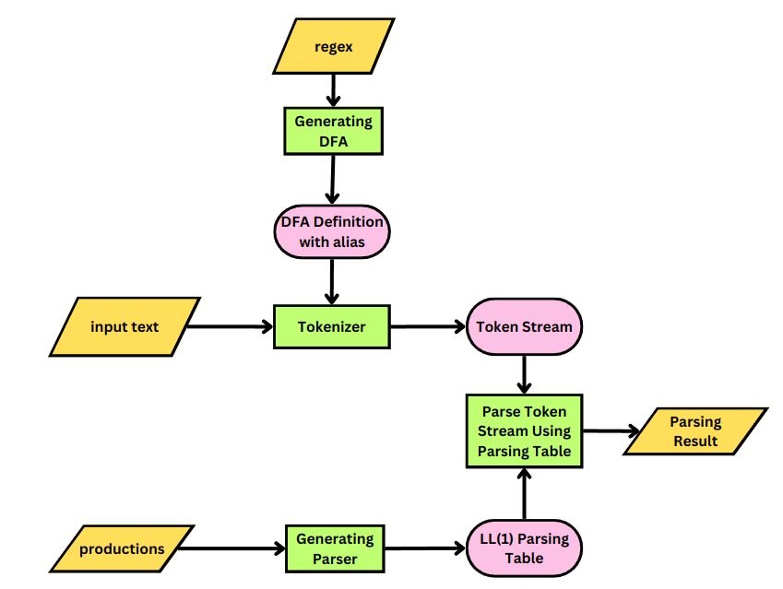
Overall Flow Diagram

Slide 5
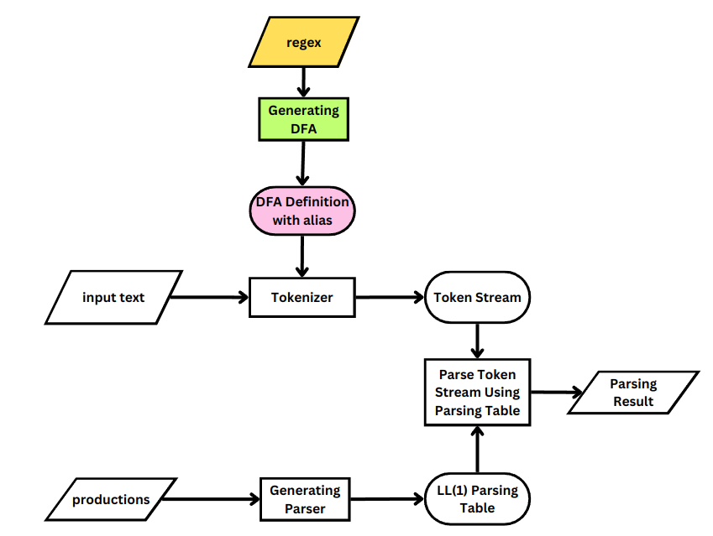
Generating DFA

Slide 6
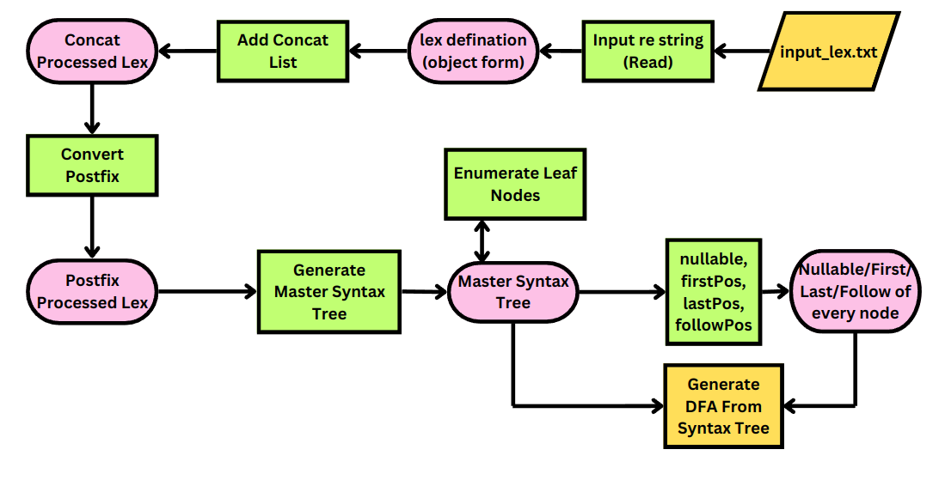
Classes and functions for DFA creation

Slide 7
Generating DFA for Lexical Analysis
It is a multi step procedure which consists of
Creation of the Regular expressions
Concat processed lex definition
Postfix processed lex definition
Creating Master Syntax tree for the regular expressions
Creating syntax tree for each regular expression
Evaluation of nullable, first-pos, last-pos and follow-pos of every node, followed by annotation
Creating DFA from syntax tree (with alias)

Slide 8
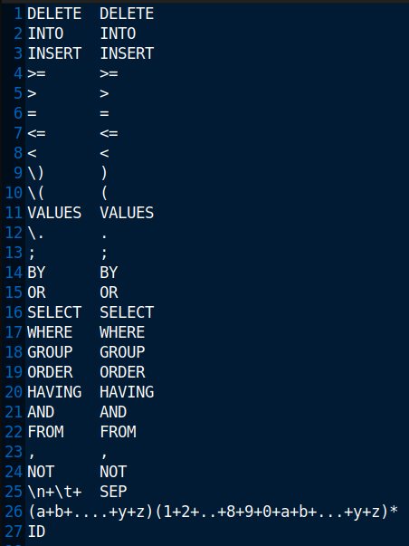
Regular Expressions
There are 26 Regular expressions
For each line (except the last two), the two values separated by tab indicate the regular expression and the token type returned by that regular expression

Slide 9

Concat Processed Lex Definition
Inserting Concatenation operator appropriately
Example:
a

Slide 10

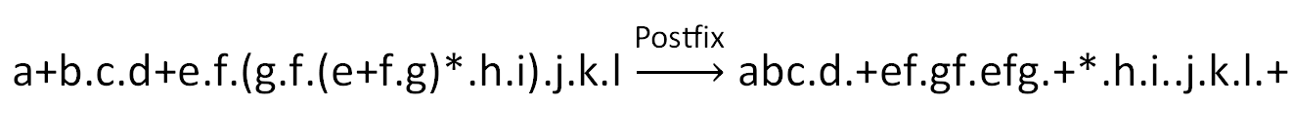
Postfix Processed Lex
Converting Infix regular expression to postfix form
Purpose: Creating syntax tree from postfix form is easier (using Stack)
Operator Precedence: * > . > +

Slide 11
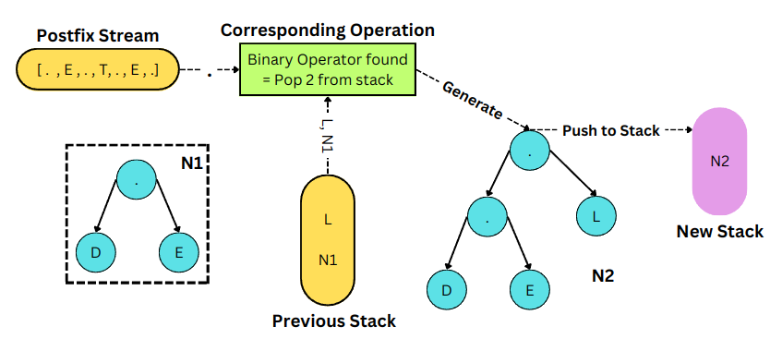
Syntax Tree from Postfix R.E.
Nodes generated by postfix evaluation using stack
At the end of reading Postfix Expression, only one node should remain in stack, else error.
Root Node = concatenation operator node with left child (from stack) and right child (#)

Slide 12
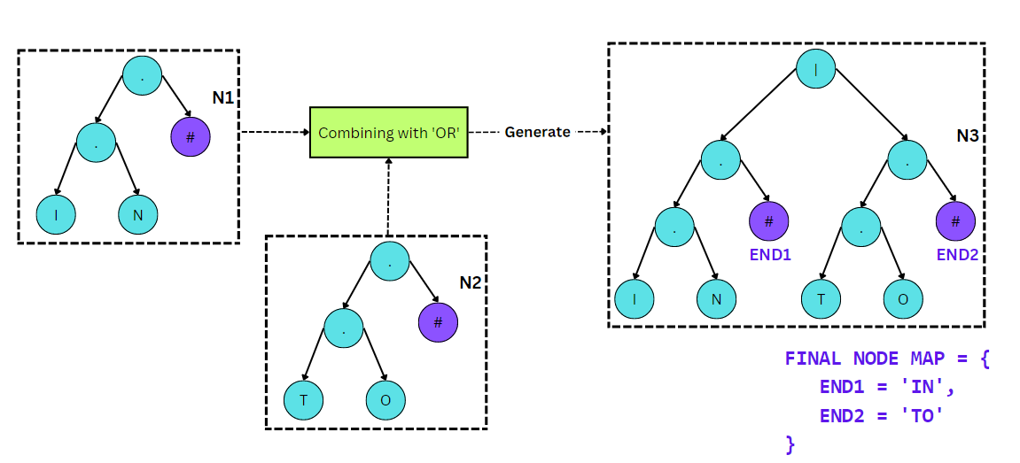
Master Syntax Tree from Individual Trees
All the individual syntax trees are Merged together using OR ( ‘|’ ) operator node.

Slide 13
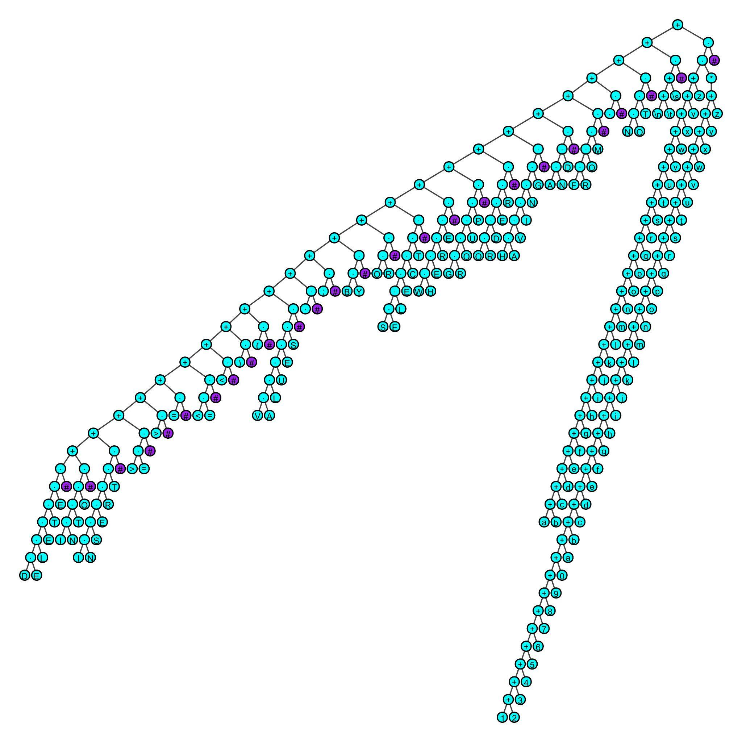
Master Syntax Tree
Diagram (SQL)
Purple: # Node (For every Token Class
Blue: Operator or Character Nodes

Slide 14
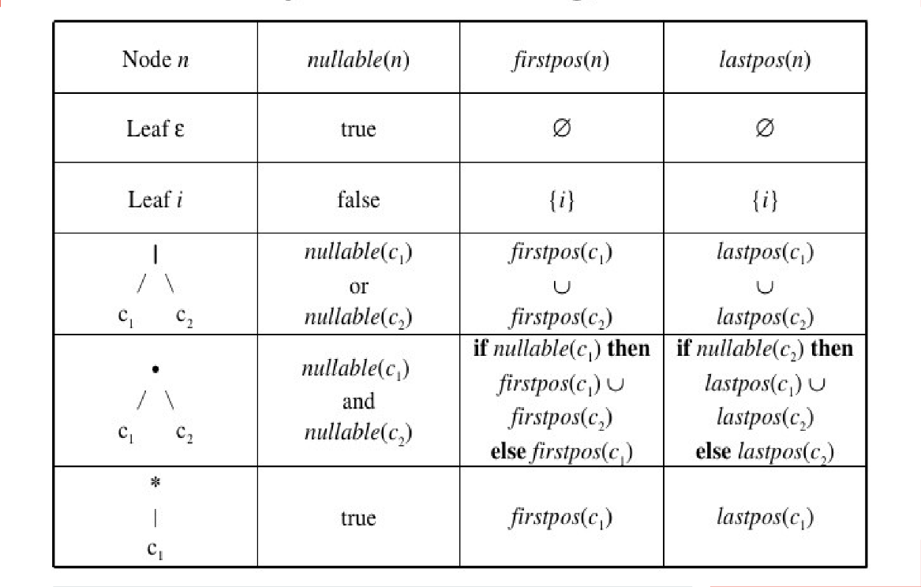
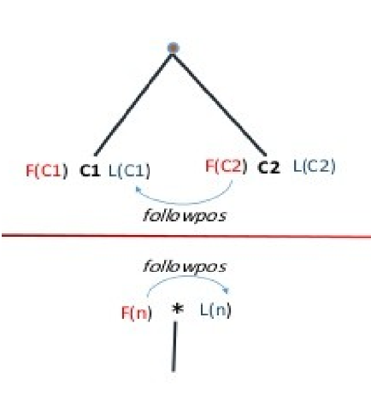
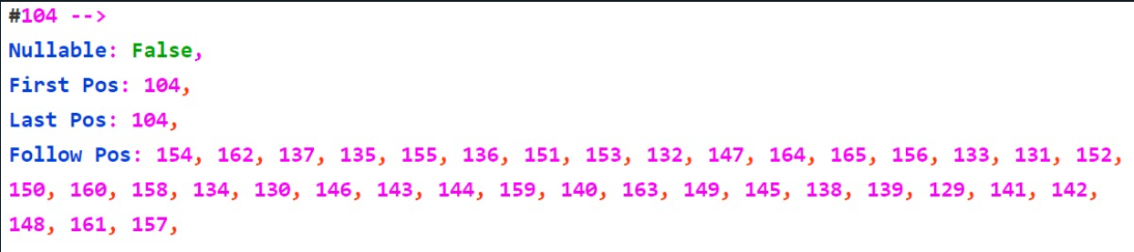
Nullable, First-pos, Last-pos, Follow-pos,

Slide 15
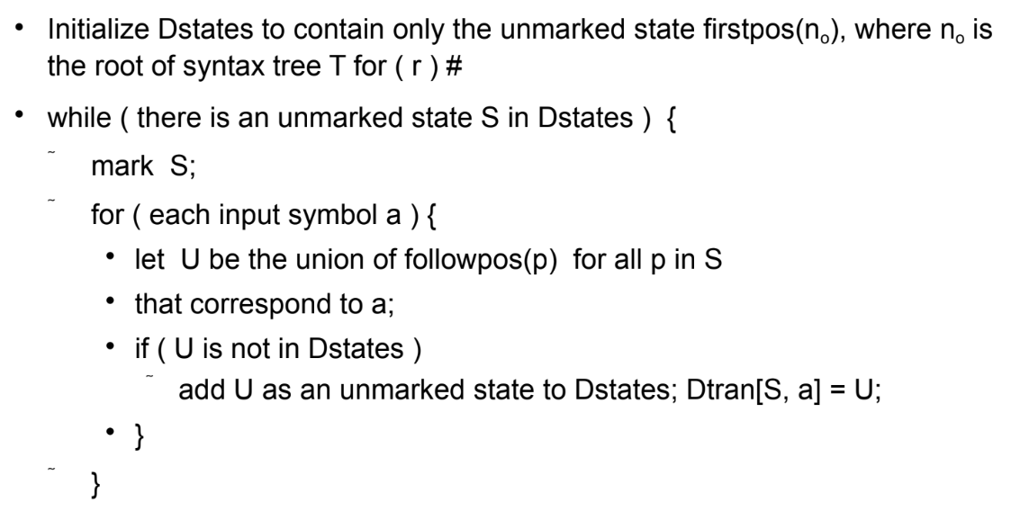
DFA from Master Syntax Tree

Slide 16
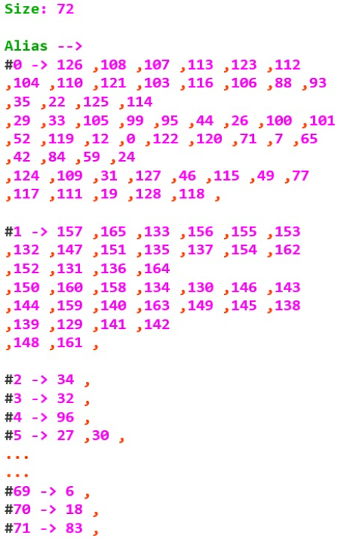
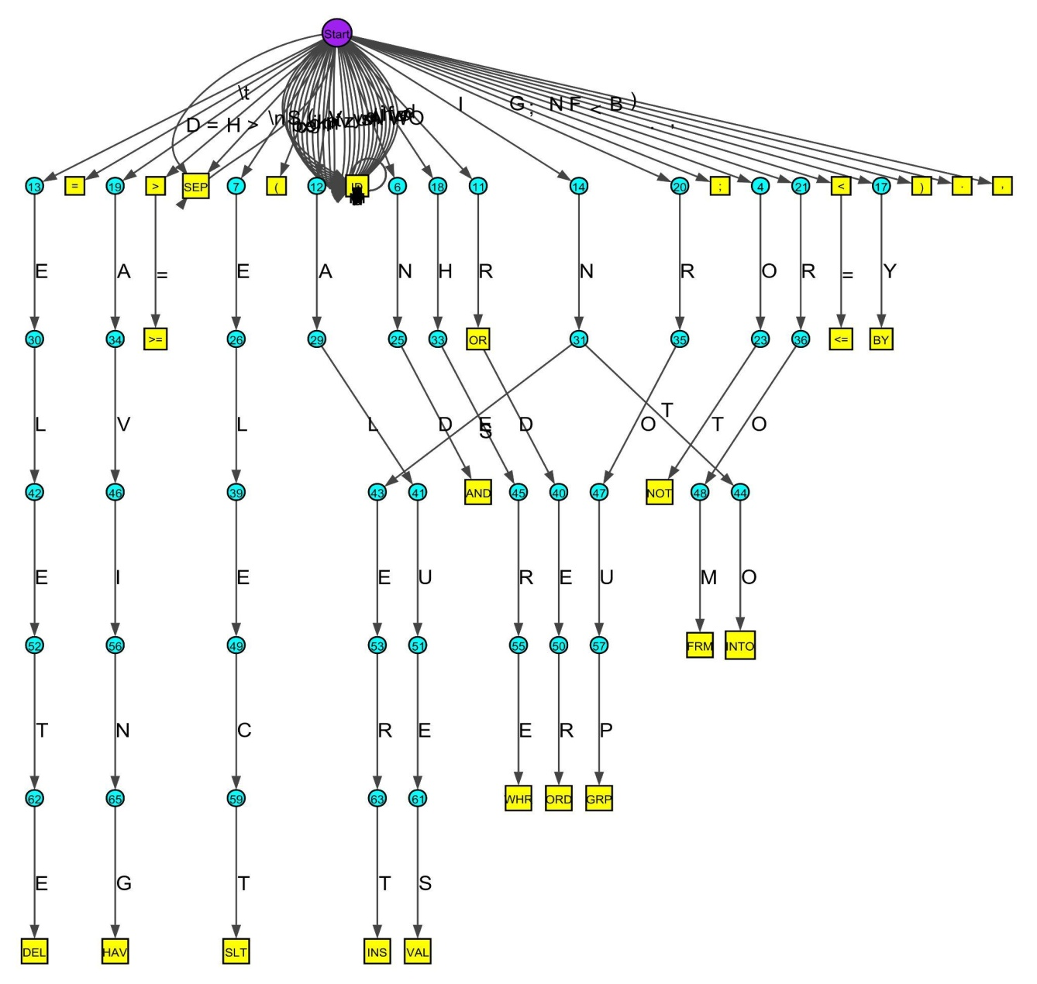
DFA Diagram
Purple: Start State
Blue: Intermediate State
Yellow: Final State (For a token class)
Alias: Set of tree nodes representing the DFA state

Slide 17
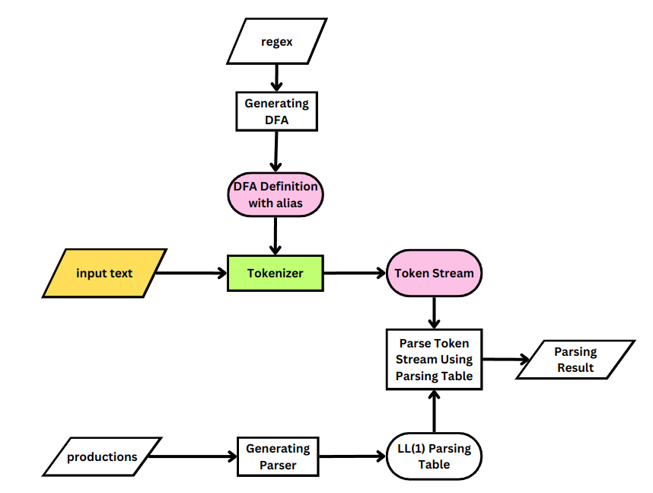
Tokenizing Input SQL Statements

Slide 18
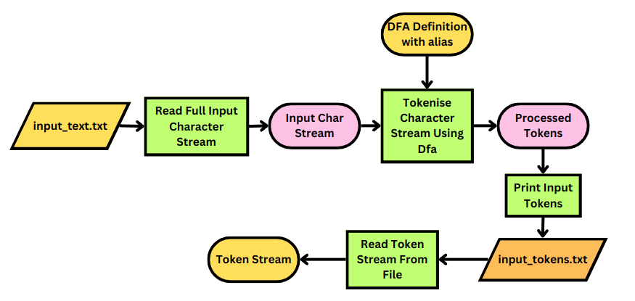
Flow diagram of Tokenizing

Slide 19
Tokenizing Rule
While creating the token, if DFA current state is not final, extend.
If currently in final state, keep transitioning till new state is also final, else return current token class
If input stream ends and left lexeme has no token class or invalid transition (can’t transition for that state and character), return INVALID.

Slide 20
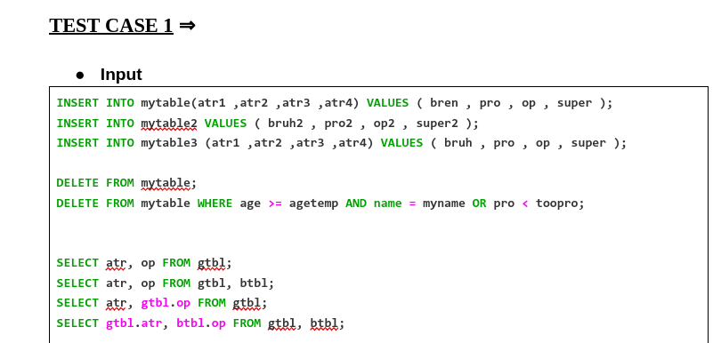
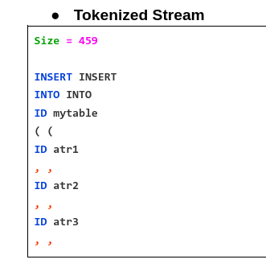
Tokenized Stream SQL Preview

Slide 21
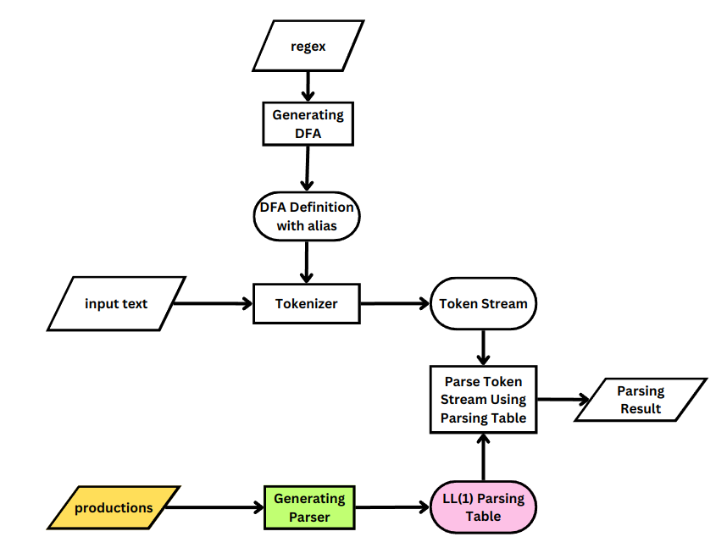
Generating LL(1) Parser

Slide 22
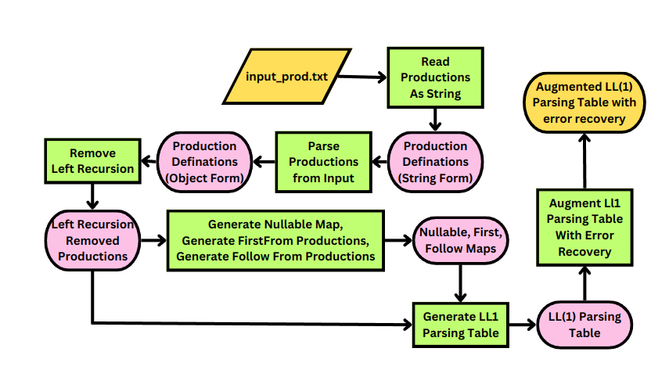
Classes and Functions for LL(1) generation

Slide 23
Generating LL(1) Grammar for Parsing
Pre Processing Productions for recognizing symbols
Left Recursion Removal
Left Factoring
Generating Nullable, First and Follow of each Non terminals
Generating LL(1) Parsing Table
Augmenting LL(1) Parsing Table (pop and scan)

Slide 24
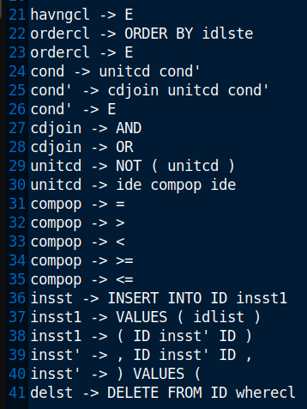
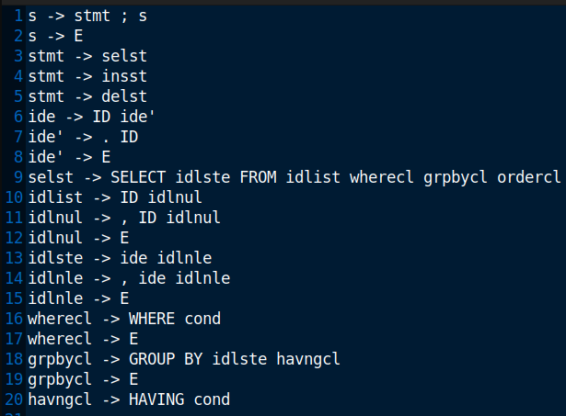
SQL Grammar
Number of productions: 41
Starting symbol: s

Slide 25
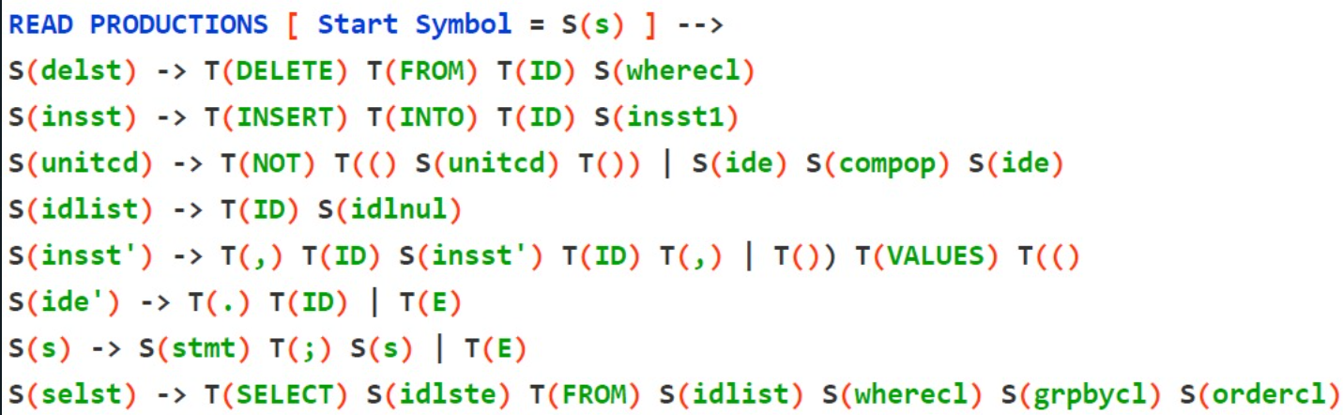
Pre-processing Productions
Reading the productions from file and identification of Terminals and Non terminals
Achieved in 2 passes
Pass 1: Recognizing Non Terminals from LHS of Productions (stored in a set)
Pass 2: Annotating every element in RHS as terminal or non terminal

Slide 26
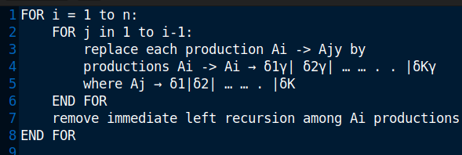
Left Recursion Removal
Immediate Left Recursion Removal
Non Immediate Left Recursion Removal

Slide 27

Left Factoring Removal
It is done to avoid ambiguity while parsing based on one terminal occuring in first set of multiple productions

Slide 28
Generating Nullable, First and Follow of each Non terminals
For production S -> S1 S2 … Si … Sn
Nullable:
all of S_{i} (i = 1 to n) are nullable
If a symbol S directly derives EPSILON (S -> E).
First Map:
first(S) = first(S₁) ∪ (if nullable(S₁) then first(S₂)) ∪ … ∪ (if nullable(S₁) && nullable(S₂) && … && nullable(S_{n-1}) then first(S_{n}))
Follow Map:
follow(S_{i}) = first(S_{i+1}) ∪ (if nullable(S_{i+1}) then first(S_{i+2})) ∪ … ∪ (if nullable(S_{i+1}) && nullable(S_{i+2}) && … && nullable(S_{n}) then follow(S))).

Slide 29
Generating LL(1) parsing Table
Row Head: Non Terminals
Column Head: Terminals
A production of the form S->S1 S2 … Si … Sn, is placed in the position (S, First(S₁ S₂ … S_{i} … S_{n})) in the LL(1) parsing table. If S is nullable, then the production is also placed in the position (S, Follow(S))

Slide 30
Augmenting LL(1) Parsing Table
Pop and Scan are inserted in empty spaces
POP:
terminal of the index of the table is end terminal (‘$’)
the terminal is present in the follow set of the symbol
SCAN:
Everywhere else

Slide 31
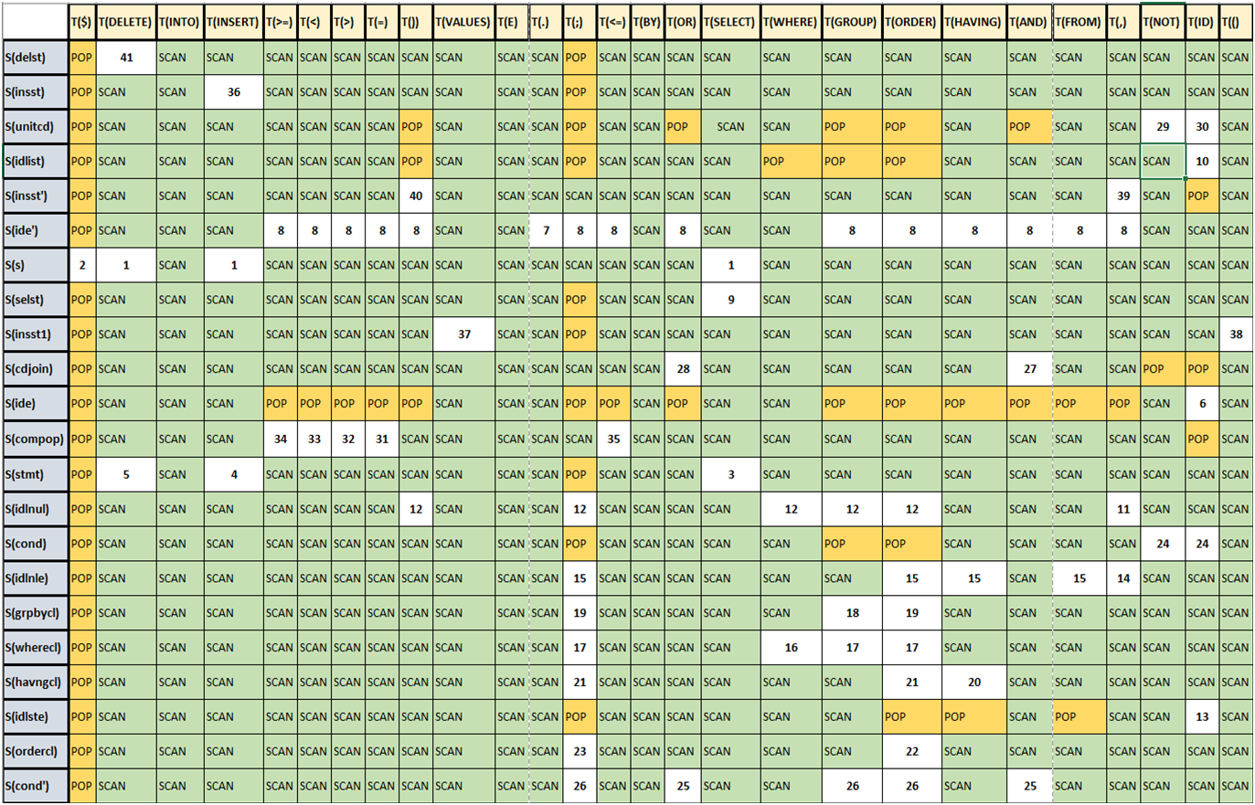
Augmented LL(1) parsing table

Slide 32
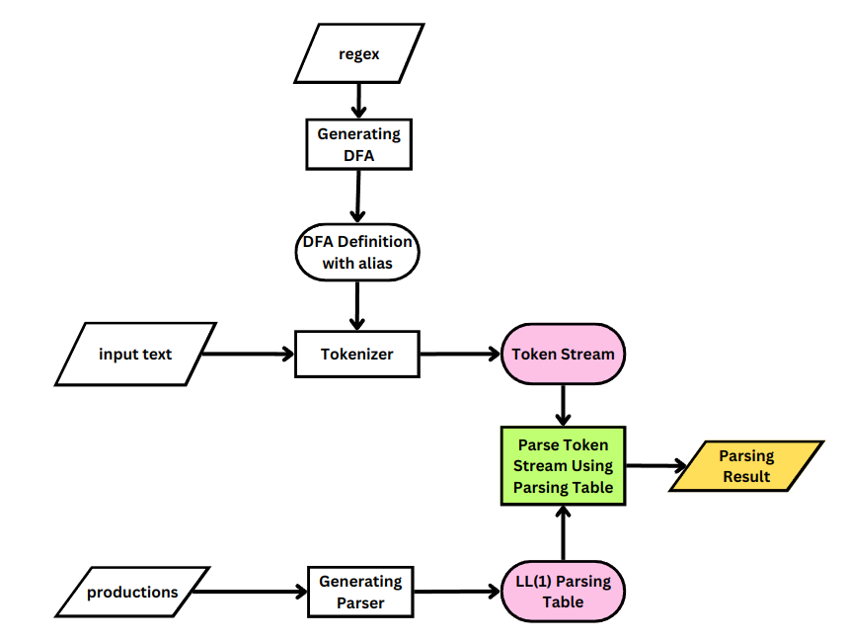
Validating SQL statements

Slide 33
Validating Using LL(1) Parser
Components:
Parsing Table
Token Stream (containing tokens ,i.e., terminals)
Parsing Stack (containing symbols and terminals)
Rules:
Parsing Stack starts with the value “S $” (where S is starting symbol)
If both terminals at top of stack and token stream match, they are popped, else throw fatal error
Else if the top of stack has a symbol, decide the action by looking from the corresponding Parsing Table entry
Parsing History was also saved

Slide 34
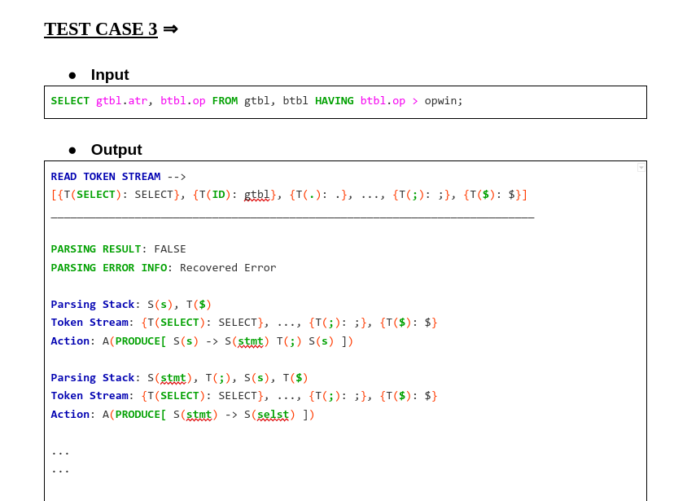

Slide 35
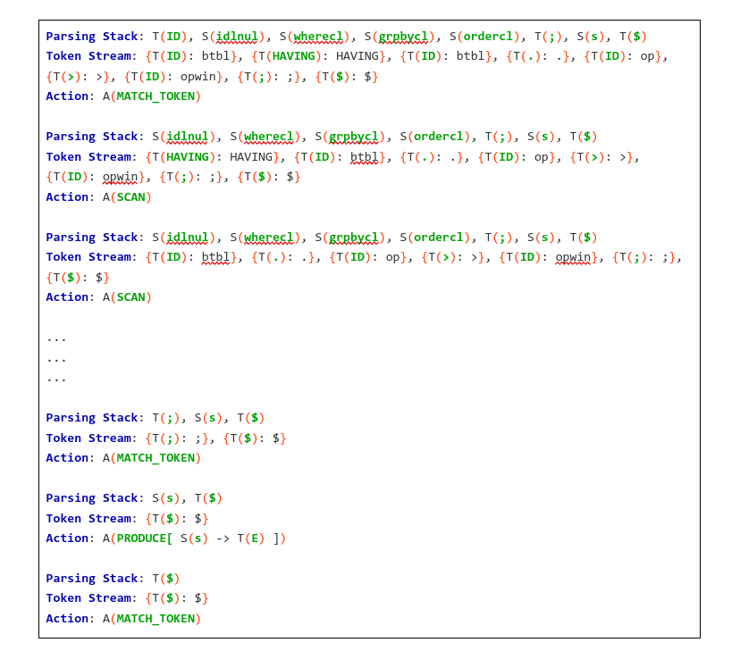

Slide 37
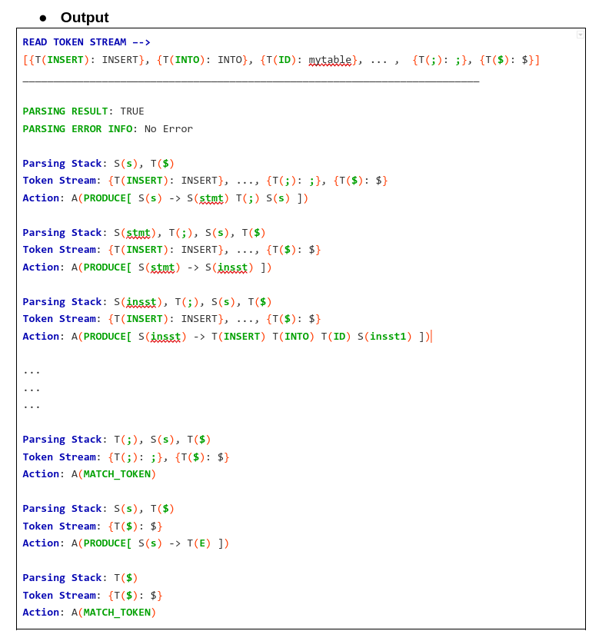

Slide 38
Thank You
Any Questions?

